Slide 1
Repetition
Notes:
Purpose
To introduce the use of loops (in BusyThings).
Learning objective
By the end of this tutorial children should be able to:
Understand that loops can be used to repeat sections of a program.
Create programs with simple loops.

Slide 2
Repetition
Sequence
Notes:
Introduce students to key vocabulary for this lesson:
Sequence: “When we sequence things, we arrange them in a particular order. Sequence-based algorithms are made from a precise set of instructions.”
Repetition: “This is the recurrence of actions or events. For example, we eat our lunch each lunchtime and might watch a favourite soap every evening. Repetition in programming means to repeat the execution of certain instructions.”

Slide 3
Why is repetition important? Repetition allows algorithms to be simplified by stating that certain steps will repeat until told otherwise. This makes designing algorithms quicker and simpler because they don't need to include lots of unnecessary steps.
Notes:
Explain to students about the importance of repetition in coding.

Slide 4
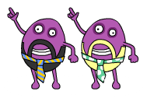
Notes:
Introduce Code Disco (Found inside Busy Things)
Children should be encouraged to try running their programs to see what happens.
They should not always expect to get it right first time.
Testing a program, seeing what goes wrong and then fixing the problem (debugging) is a very important part of coding. Tutorials and challenges in Code Disco always build on what has been learned previously.
Children should be encouraged to think about what they've just learned, and see how it can be adapted and extended to solve other problems. Breaking a problem down into simpler problems and then combining the solutions is a very useful strategy in coding.

Slide 5
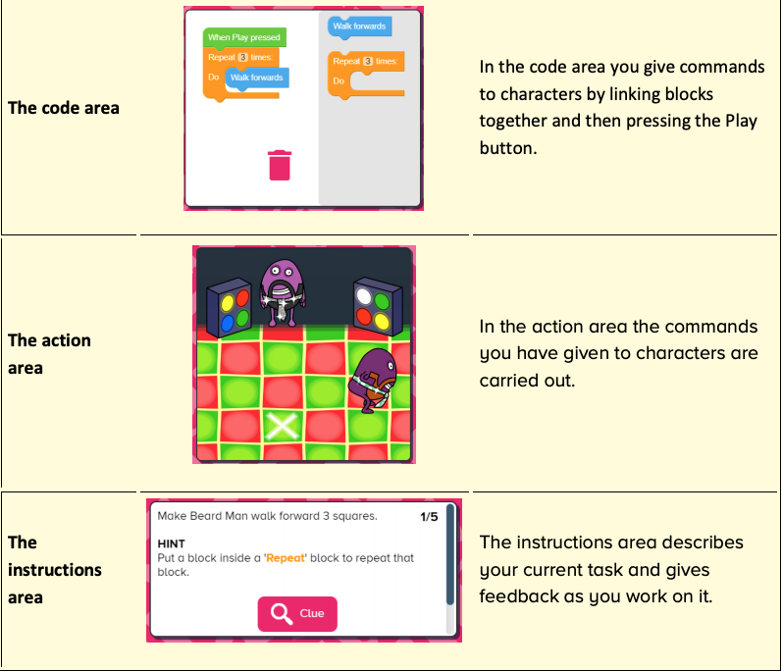
Notes:
Introduce students to Busy Code focusing on these 3 areas:
Code area
Action area
Instruction area

Slide 6
Notes:
Show students the repeat/loop block found within Busy Code.

Slide 7
Notes:
Introduce the Tutorials section of Busy Things (10/15 mins)
Tutorials consist of multiple steps that can be worked through and introduce a concept.
The objective will be presented in the instructions area in the bottom left of the screen, along with any hints that may help children to complete the stage. Some steps include a clue button which will give a visual clue, normally where a new block type is introduced or an existing block type is used in a new way.
Once each stage is complete, a next button will appear allowing children to move onto the next stage.
Once the final stage has been completed, children can either try any related challenges or projects or can move onto the next tutorial.
You may want to demo this with your students when going through the first instructions together (you want to stop your students at various points to keep everyone on target)

Slide 8
Notes:
Introduce the Challenge section of Busy Things (10/15 mins)
Challenge resources work in a similar manner to the tutorial resources, but the problems are harder to solve. They are intended to test that children have grasped the concepts introduced in the preceding tutorials.
Each task in a challenge has a suggested block limit the children should try to stay within.

Slide 9
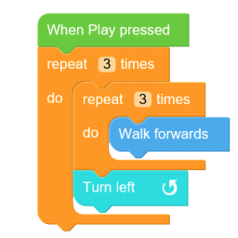
Notes:
Challenge 2 Answer
Loopy Objective
Solution challenges may have many different correct solutions.
The image displayed is an example of a correct solution which also stays within the target block limit.

Slide 10
Notes:
Introduce the Project section of Busy Things (30 mins)
Project resources are open-ended tasks that give children the chance to be creative with what they have learned so far.
Each project is concentrated on a specific theme and only provides the relevant blocks/characters/props needed to work within that theme. There are no correct answers and children should be encouraged to experiment.
Projects are often provided in multiple versions, so children can revisit a similar idea once they have learned more and elaborate on their previous ideas. Projects can be saved in Code Disc.
Allow some time at the end of the session to allow students to showcase their work.

Slide 11
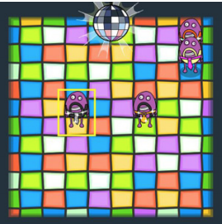
Notes:
Project: Dancing 2
Objective The Dancing 2 project builds on Dancing 1, introduced in level 1. The 'Repeat' block is now included so children can more easily create extended dance routines with repeated patterns.
Project resources are open-ended tasks that give children the chance to be creative with what they have learned so far. Each project is concentrated on a specific theme and only provides the relevant blocks/characters/props to work within that theme. There are no correct answers and children should be encouraged to experiment. Projects are often provided in multiple versions, so children can revisit a similar idea once they have learned more and elaborate on their previous ideas. Projects can be saved.
Allow time at the end of the session to share their dances with each other, to do this remind student they need to have named and save their project.

